Slide 1




GROUP MEMBERS :
MUHAMMAD AMMAR SIDDIQUI(20K-0177)
MUHAMMAD ZUNIQUE(20K-0145)
MUHAMMAD MUAZ ZAFAR(20K-0363)
MUHAMMAD SAAD(20K-0189)
Teacher:
MISS AMBER SHEIKH

Slide 2


INTRODUCTION
In this presentation we will discuss a real world application of linear algebra in cryptography and we will show how linear algebra is play a vital role in maintaining our daily life privacy.
DEFINITION
The prefix "crypt-" means "hidden" or "vault“ and the suffix graphy stand for writing so Cryptography is the study of the techniques of writing and decoding messages in code. Cryptography is the process of converting ordinary plain text into unintelligible text and vice-versa .
EXPLANATION:
In cryptography Codes are called ciphers, uncoded messages are called plaintext. It is a method of storing and transmitting data in a particular form so that only those for whom it is intended can read and process it. Coded messages are called cipher text. The process of converting from plaintext to cipher text is called enciphering, and the reverse process of converting from cipher text to plaintext is called deciphering.

Slide 3
THE BACKGROUND OF CRYPTOGRAPHY
\
Cryptography is a process that converts the text of a message or data, into a scrambled message, that obscures the original message, and then the recipient can convert the scrambled message back to the original.
Cryptography can be traced back to the ancients, with the first documented use dating to 1900 BC in ancient Egypt with substituted hieroglyphics. A more modern approach with a substitution cipher can be found with Julius Caesar in 100 BC, where each letter was substituted with another letter to scramble the message, in what became known as a ‘3 cipher’ that moved each letter three ahead in the alphabet to keep it secure.
This ‘Caesar Cipher’ was used to send secure messages to the Roman generals on the front line but is considered less secure by modern standards as it only used an encryption method, and did not utilize an encryption key, and therefore is subject to being easily decrypted based on the frequency of the letters.

Slide 4
The history OF CRYPTOGRAPHY
\
The art of cryptography is considered to be born along with the art of writing. As civilizations evolved, human beings got organized in tribes, groups, and kingdoms. This led to the emergence of ideas such as power, battles, supremacy, and politics. These ideas further fueled the natural need of people to communicate secretly with selective recipient which in turn ensured the continuous evolution of cryptography as well.
The roots of cryptography are found in Roman and Egyptian civilizations.
The first recorded use of cryptography for correspondence was by the Spartans, who as early as 400 bc employed a cipher device called the scytale for secret communication between military commanders.

Slide 5
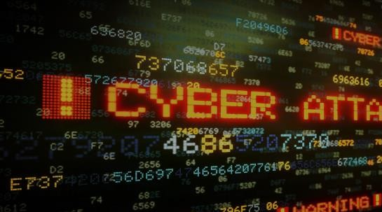
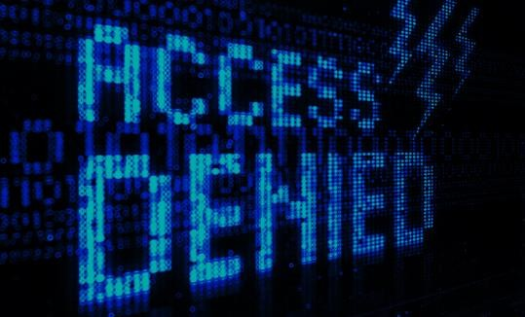
HOW CRYPTOGRAPHY IS LINKED WITH LINEAR ALGEBRA
A matrix can be used as a cipher to
encrypt a message. The matrix must be invertible for use in decrypting. Cipher matrix can be as simple as a 3x3 matrix composed of random integers. In order to encrypt plaintext, each character in the plaintext must be denoted with a numerical value and placed into a matrix.
It was mainly used for the security needed for passwords but now cryptography is very important due to the Internet's flow of sensitive information such as credit card information and other sensitive information which is easy to monitor by unintended third hand parties.
The idea behind enciphering a message is to make it worthless to everyone except for the party with the deciphering "key".
In cryptography (writing codes) we use linear in
several geometrical crypto systems. For example, some types of elliptic curve cryptography (ECC) incorporate a series of matrix transformations as part of decryption and encryption. IN cryptanalysis (breaking codes mathematically) we use linear in solving systems of equations related to both a grammar or language in cipher text and the corresponding incidence/probability of such language given our knowledge of that cryptosystem.
This is a whole field of cryptanalysis called linear cryptanalysis - so named because of its use of linear algebra. We are sure you would also use linear in some other ways. For example, we could imagine you using linear in proving some stuff about the size of the set of potential keys or the probability of brute forcing some cipher text.

Slide 6

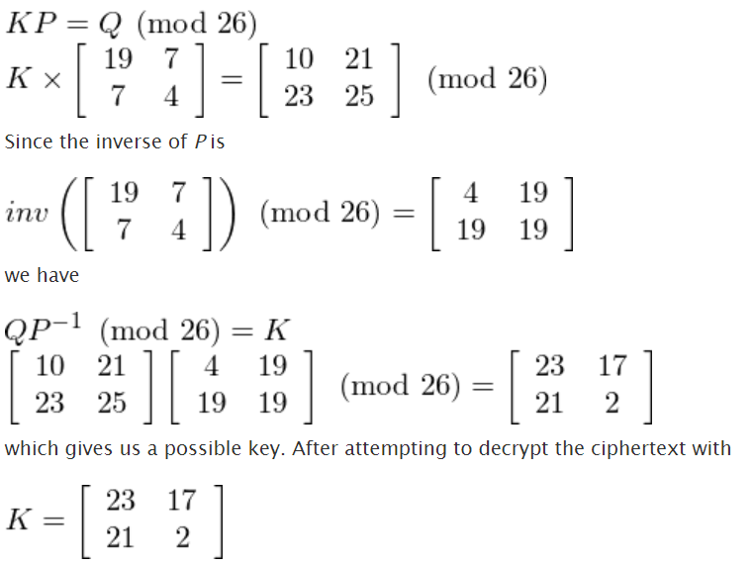
HILL CIPHER:
HILL CIPHER:
KEY COMPONENTS:
Cipher Matrix (Key) K
Plain Matrix (Obtained by converting plain text into ASCII values)
Decipher Matrix (Inverse of Cipher Matrix) K⁻¹
IS HILL CIPHER AN EFFICIENT CYPHING ALGORITHM?
The basic Hill cipher is vulnerable to a known-plaintext attack, however,(if you know the plaintext and corresponding ciphertext the key can be recovered) because it is completely linear.
For the case of a 2 by 2 hill cipher, we could attack it by measuring the frequencies of all the digraphs that occur in the ciphertext. In standard English, the most common digraph is 'th', followed by 'he'. If we know the hill cipher has been employed and the most common digraph is 'kx', followed by 'vz' (for example), we would guess that 'kx' and 'vz' correspond to 'th' and 'he', respectively. This would mean [19, 7] and [7, 4] are sent to [10, 23] and [21, 25] respectively (after substituting letters for numbers). If K was the encrypting matrix, we would have:

Slide 7
HILL CIPHER:
HILL CIPHER:
we would know whether our guess was correct. If it is not, we could try other combinations of common ciphertext digraphs until we get something that is correct.
In general, the hill cipher will not be used on its own, since it is not all that secure. It is, however, still a useful step when combined with other non-linear operations, such as S-boxes (in modern ciphers). It is generally used because matrix multiplication provides good diffusion (it mixes things up nicely). Some modern ciphers use a matrix multiplication step to provide diffusion e.g. AES and Twofish use matrix multiplication as a part of their algorithms.

Slide 8



Results
Now by using linear algebra we have finally encrypted the message “National University of Computer and Emerging Sciences” and we can also decrypt this message using the key. Similarly, by using hill cypher and matrix multiplication we can secure and encrypt any normal text message no matter how long the text, we can encrypt it and make it safer to transfer it over the internet.
Group Discussion and Observation
During the group discussion and observation, we discovered that linear algebra has so much vast application in the real world and how it is so much useful.
We discovered how our daily life messages on WhatsApp or our emails that are sent through the internet are secured and encrypted using cryptography.
Cryptography is vast topic, and it has so many applications in our daily life. It has so many techniques and methods. There are Algorithms for cryptography some are weak and some are so strong that whole companies run on the basis of its securty

Slide 9


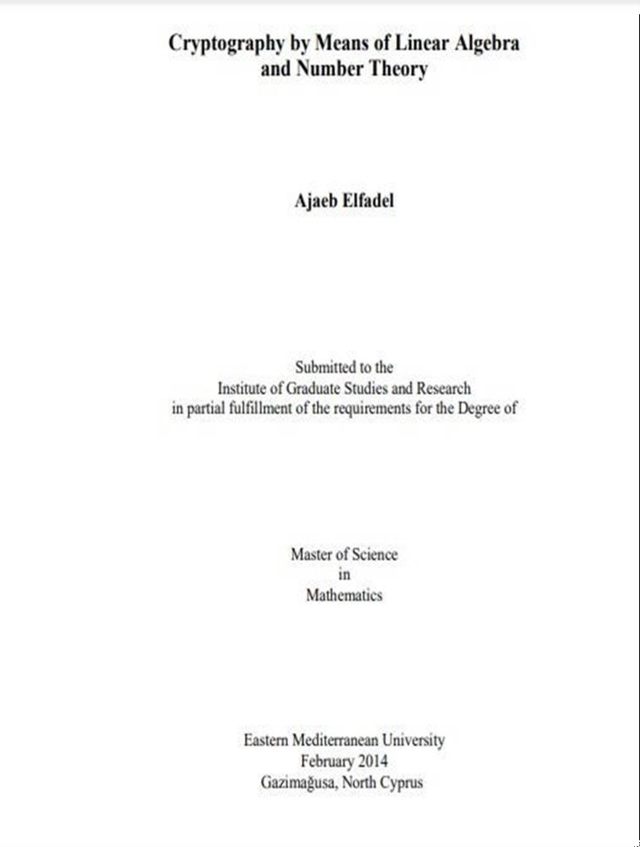
REFERENCES,BIBLIOGRAPHY
1) BOOK NAME :
2) LINKS :
http://i-rep.emu.edu.tr:8080/xmlui/bitstream/handle/11129/1420/ElfadelAjaeb.pd f?sequence=1
https://www.youtube.com/watch?v=S_2MV3ncHj0 https://www.youtube.com/watch?v=xy4vHN5-zvM
http://www.practicalcryptography.com/ciphers/hill-cipher/

